Slide 1


Achieving your Objectives through Digital Readiness
Secure the safety of people in and around buildings (High Level Issues)
Regulate HRBs (BSA gateways)
Oversee building control
Enforcement compliance
Provide guidance
Engaging with residents
Hackitts conclusion ‘Culture of Indifference and Complacency’
Jeremy Barnett

Slide 2
Current issues
Building Safety Act Delays
Average approval rates 9-43 weeks (target 12 weeks)
Incomplete submissions
40% failure rate of applications
The backlog of gateway 2 applications
Building control oversight following collapse of Assent
Resource issues
Hence this meeting: how can we use AI to resolve some or all of these issues
Jeremy Barnett

Slide 3
Addressing the failure rate
Overall Rejection/invalidation rate 45-70%
Approval rate was initially low 14% general, 10% for new build projects
Reasons for failure
  40-44% initial applications rejected due to missing basic information or legal documentation
  73% did not meet legal standards/lacked necessary detail
  45% proposed work that would breach building regulations.
Substantial recent improvements, new Innovation Unit achieving 12-13 week approvals
Our interaction with clients shows they are still treating this as a box-ticking exercise rather than operating a stage gateway process
We recommend developing an industry standard workflow with the Innovation Unit.

Slide 4

Achieving Maximum Impact from AI
Regulator AI Capability
Nil
Tacticial
Complex
Not cost/time effective
Manual
Slow &
inaccurate
Not possible
Quicker approvals with accurate data
Dramatic approval time and cost savings
Automated Collation of data
Fully automated recommendation
system
TwinTrace
Lifetime Golden Thread
‘Digital Twin’
Powerful & cost effective safety predictions and enforcement engine at speed
Safe Buildings

Slide 5







5 layers of value for data
(relevant to both Client and BSA modules)
INTELLIGENCE
‘Reggie AI Agent’
WORKFLOW INTEGRATION
OWNERSHIP &
ACCESS
SUPPORTING MULTIPLE DATA TYPES
TwinTrace
VERIFICATION/
APPROVAL
Jeremy Barnett
Growth 2024
by Community Experience

Slide 6
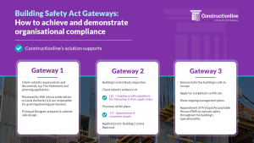
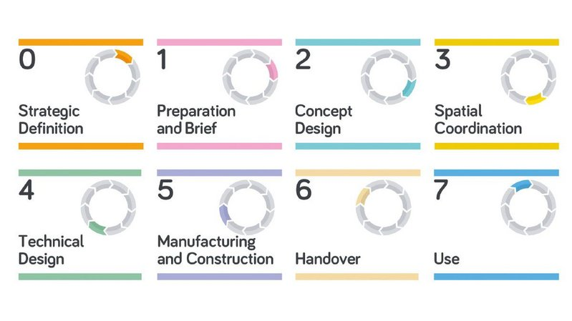
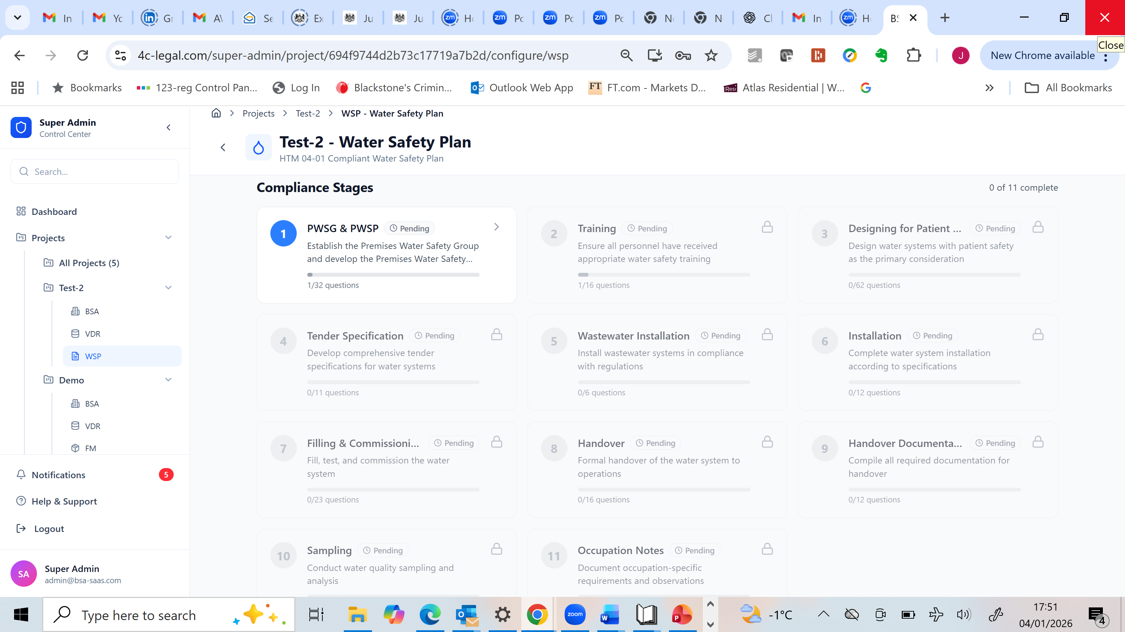
Gateway Management
For clients to collect data
RIBA plan of work
Golden Thread for Lifetime of Building
‘End of lawyers’
Building Safety Act
BSA document submission
For the Regulator
Workflow with gateway meetings
New Water Safety Module
Growth 2024
by Community Experience

Slide 7
ub
Building your AI Capability
Scope of UCL Research Project
Tactical
Major collaboration
Options for Collation of data
Labour intensive but efficiency savings
Replace Portal with free TwinTrace
Some benefits in the approval process
automated sift of applications
Build BSR white label version of TwinTrace with workflow – Clients pay perhaps for a ‘fast lane?’
Reduces failure rate of applications
50- 75% speeding up of approval system
Fully automated recommendation
system
Driving cultural change which improves safety and resolves high level objectives.
Support use of independent
‘Digital Twins’
Safe Buildings

Slide 8
Achieving your Objectives through Digital Readiness
BSA gateways management
Oversee building control
Enforcement compliance
Provide guidance
Engaging with residents
Hackitt’s conclusion ‘Culture of Indifference and Complacency’
.
TwinTrace document regulator module
Gateway management approval system
Automated Monitoring and reporting
Enhanced version of ‘Reggie’
Digital Twin Dashboard
Whole of ‘building life’ immutable digital twin by regular gateway meetings

Slide 9
Our Recommendations
TACTICAL
Replace Portal with BSA module from current version of TwinTrace
Design and build white label version of TwinTrace to speed up BSA approvals
  BSA Module + enhanced gateway management workflow
  Simplified Virtual Data Room of legal documentation required for BSA approval
  Healthcare module.
  Regulator Module with enhanced approval gateway management workflow
3. Design AI module with UCL to sift approvals
LONGER
TERM
Develop AI module with UCL to recommend approval + traffic light gap analysis for clients
Promote or release white label version of PIM
  Gateway management for entire development/construction team
  Searchable
  Includes Virtual Data Room and FM modules

